Slide 1
Projects

Slide 2
1. Spam detection
Dataset:
  4.6k records, 1.8k spam
  Columns, e.g. word_freq_make, word_freq_address, capital_run_length_average, etc.
Task:
  build a fully connected classifier network that will classify the mails.
  check which parameters affect decision the most (biggest gradient wrt to answer)
  build a classifier that doesn't use 1, 2, 10 most significant parameters. Does it still perform better then random?

Slide 3
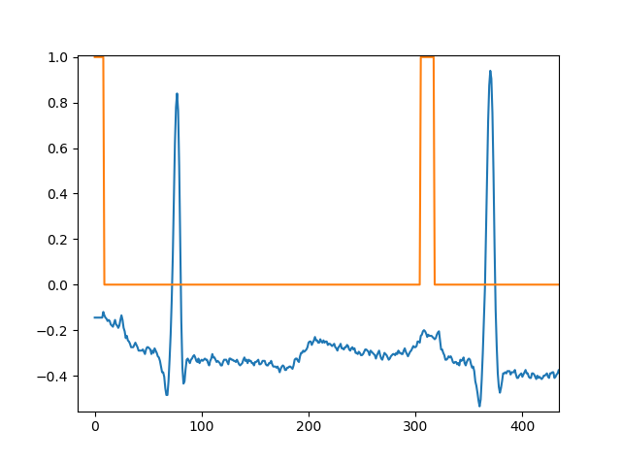
2. ECG
Data:
  ~1 h, 360 sps 1D signal + P wave annotation
Aim:
  Create a 1D DNN to predict each sample's class (predicts for a single sample).
  Create a 1D FCN to predict each sample's class for the whole crop.
  Try receptive fields of 0.5, 1, and 2 periods. You might want to downsample the data
  How would you measure the resulting performance?

Slide 4
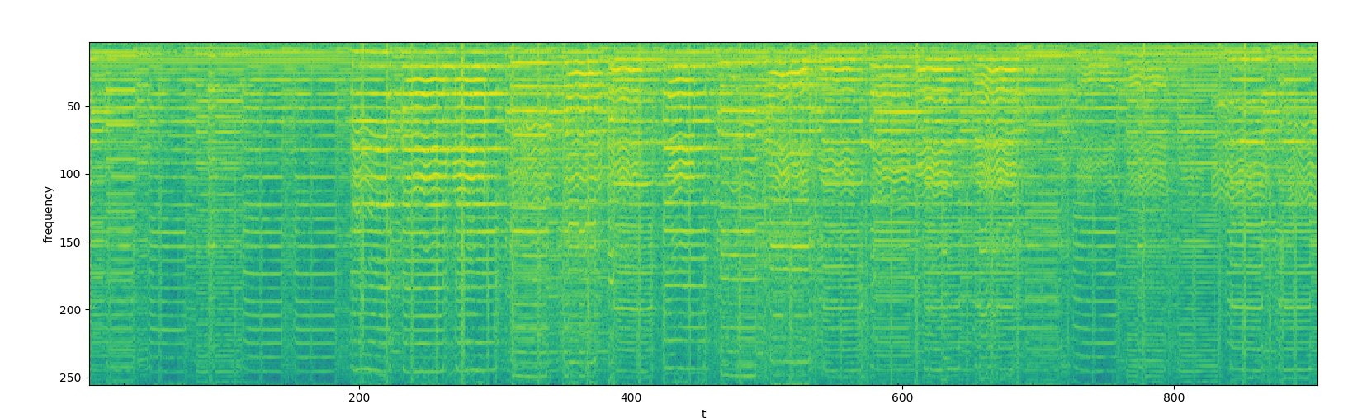
3. Music and Speech, DNN
Data:
  Gtzan dataset, 64 of 30 sec samples, for each
  Fourier transformed to 2d map of amplitudes for frequency vs time
Aim:
  create 64 time-samples long patches with overlap of 32 from all music and speech files. assign labels accordingly
  build a classifier net, (e.g. 4 convolutional layers, use stride of 2; and 2 fully connected layers). try different activation functions (relu, tanh, sigmoid).
  Train on 80% of the data and validate on remaining 20, study the convergence.

Slide 5
4. Music and Speech, RNN
Data:
  Gtzan dataset, 64 of 30 sec samples, for each
  Fourier transformed to 2d map of amplitudes for frequency vs time
Aim:
  Build LTSM network, where a cell predicts speech vs music
  Same as in DNN, but feed sequentially the consecutive time samples
  Look on performance depending number of used time steps (5-32)

